Slide 1
Lab 7
by wwy

Slide 2
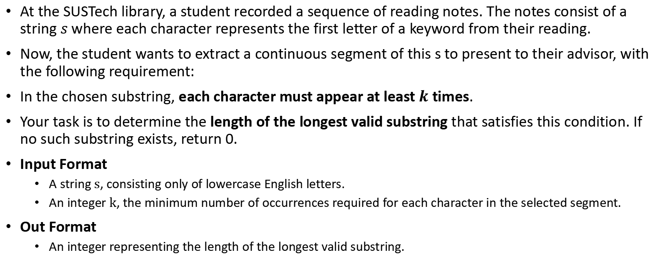
Lab 7A
At the SUSTech library, a student recorded a sequence of reading notes. The notes consist of a string $s$ where each character represents the first letter of a keyword from their reading.
Now, the student wants to extract a continuous segment of this s to present to their advisor, with the following requirement:
In the chosen substring, each character must appear at least $k$ times.
Your task is to determine the length of the longest valid substring that satisfies this condition. If no such substring exists, return 0.
Input Format
A string $s$, consisting only of lowercase English letters.
An integer $k$, the minimum number of occurrences required for each character in the selected segment.
Out Format
An integer representing the length of the longest valid substring.

Slide 3
Lab 7A sample1
Input: ddbbb 3
Output: 3
Explanation: The substring "bbb" is valid since 'b' appears 3 times.

Slide 4
Lab 7A sample2
Input: acabbab 2
Output: 5
Explanation: The substring "abbab" is valid since 'a' appears 2 times and 'b' appears 3 times.

Slide 5
Lab 7B
You are given a list of rectangles on a 2D plane. Each rectangle is represented by a triplet [left_i, right_i, height_i], where:
left_i is the x-coordinate of the left edge of the rectangle,
right_i is the x-coordinate of the right edge (exclusive),
height_i is the height of the rectangle.
Each rectangle extends vertically from height 0 up to height_i, and spans horizontally from left_i to right_i.
All rectangles have a width along the x-axis and are aligned with the axes.
Your task is to compute the outline of the combined shape formed by these rectangles, as seen from the front (along the y-axis).
This outline can be represented by a list of key points which indicate where the height of the shape changes.

Slide 6
Lab 7B
Input Format
An array rectangles of shape n x 3, including left_i, right_i, height_i.
Output Format
A list of key points x1 y1, x2 y2, ..., sorted in increasing order of x.
Each key point represents a horizontal position x where the height changes to y.
Consecutive key points must not have the same height value.
The final point should represent the drop to ground level (`height = 0`) at the end of the last rectangle.

Slide 7
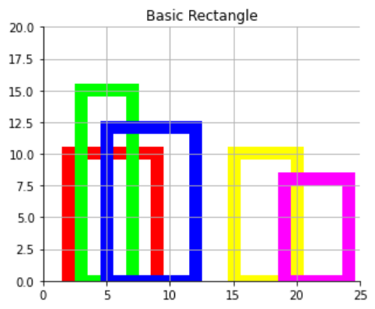
Lab 7B sample
2 9 10
3 7 15
5 12 12
15 20 10
19 24 8
Input
Output
2 10
3 15
7 12
12 0
15 10
20 8
24 0

Slide 8
THX:-)

